Slide 1
DIGITAL PORTFOLIO
STUDENT NAME : M.Divya Dharshini
RESIGTER NO AND NMID :2428B0218, 01537FCC9E639E58D304F3899E
DEPARTMENT : BSC Computer Science With Data Analysis
COLLEGE : College / University: Tiruppur Kumaran College For Women / Bharathiyar University

Slide 2
PROJECT TITLE
MY DIGITAL PORTFOLIO

Slide 3

AGENDA
1.Problem Statement
2.Project Overview
3.End Users
4.Tools and Technologies
5.Portfolio Design and Layout
6.Features and Functionality
7.Results and Screenshots
8.Conclusion
9.Github Link

Slide 4

PROBLEM STATEMENT
Doctors often face challenges in maintaining and presenting their professional achievements using traditional paper-based records. Certificates, research work, and case studies are usually scattered and unorganized, making it difficult to access or share them when needed. This lack of a centralized and structured system reduces efficiency, limits visibility and affects opportunities for career growth and recognition.
In today’s digital era, there is a need for an easily accessible, well structured, and interactive platform where doctors can present qualifications, and contributions to the medical field. Sharing accomplishments with recruiters, institutions, or patients becomes time-consuming, and accessibility to a doctor’s expertise is limited.

Slide 5

PROJECT OVERVIEW
Brief Summary
The Medical Digital Portfolio is a modern platform that helps doctors showcase their qualifications, skills, research, and achievements in a structured and professional way. It replaces traditional paper-based records with a centralized, easy-to-access system.
Portfolio Contains
About me& Educational qualifications
Specialization& Services
Experience
Contact
Main idea
To provide doctors with a professional digital space that organizes and presents their career journey, making it easily accessible for recruiters, institutions, and patients.

Slide 6
WHO ARE THE END USERS ?
Doctors – To showcase their skills and achievements.
Recruiters/ Hospitals – To verify credentials for hiring.
Medical Institutions – To assess academic and professional records.
Patients – To know doctor’s expertise and experience.
Research Community – To access studies and publications.

Slide 7
TOOLS AND TECHNIQUES
HTML
Used to structuring the content of the portfolio such as About me, Educational qualification, Service, Specialization, Experience and Contacts.
2. CSS
Applied for styling, layout and visual design to make the portfolio attractive and readable.
3. Java Script for Navigation
Internal links ensure smooth movement between different sections of the portfolio.
4. Responsive
Basic technique were used to make the portfolio viewable on desktops and mobile devices.
5. Code Editor
CODEPEN

Slide 8
PORTFOLIO DESIGN AND LAYOUT
About me – Personal details, career goals, and professional summary.
Educational qualification – Academic qualifications
Specialization – Medical expertise, clinical skills
Work Experience – Hospital / Clinical experience
Contact Section – Email and phone

Slide 9
FEATURES AND FUNCTIONALITY
User-friendly Design: Clean and Simple layout that is very to navigate.
Navigate Function: Provides internal links for moving between sections like About me, Experience, Services and Contacts.
Contact Function: Provides email and phone number
Responsive Function: Ensures the portfolio adapts to different devices(desktops, tablet, mobile)

Slide 10

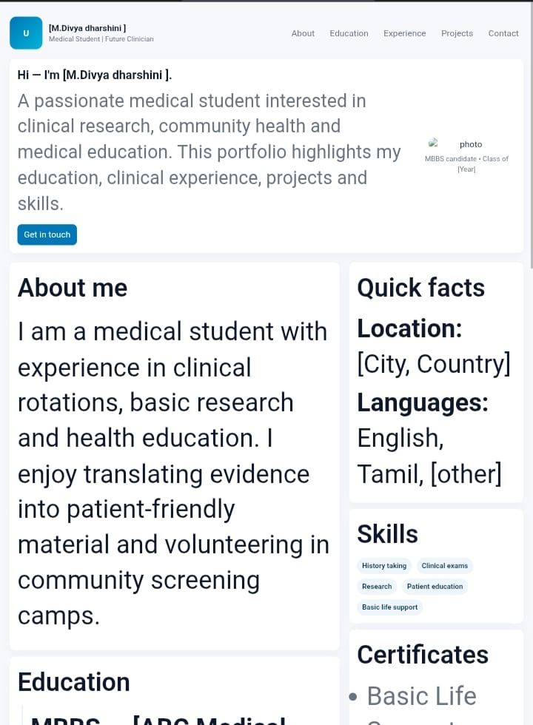
!DOCTYPE html>
<html lang="en">
<head>
<meta charset="UTF-8">
<meta name="viewport" content="width=device-width, initial-scale=1">
<title>Dr. Jane Smith - Medical Portfolio</title>
<link rel="stylesheet" href="style.css">
RESULTS AND SCREENSHOTS

Slide 11
CONCLUSION
A medical digital portfolio provides a professional showcase of skills, experience, and achievements. It helps in building credibility and enhancing communication with patients, peers, and institutions. Serves as a comprehensive record for career growth, research and continuous learning.

